Slide 1
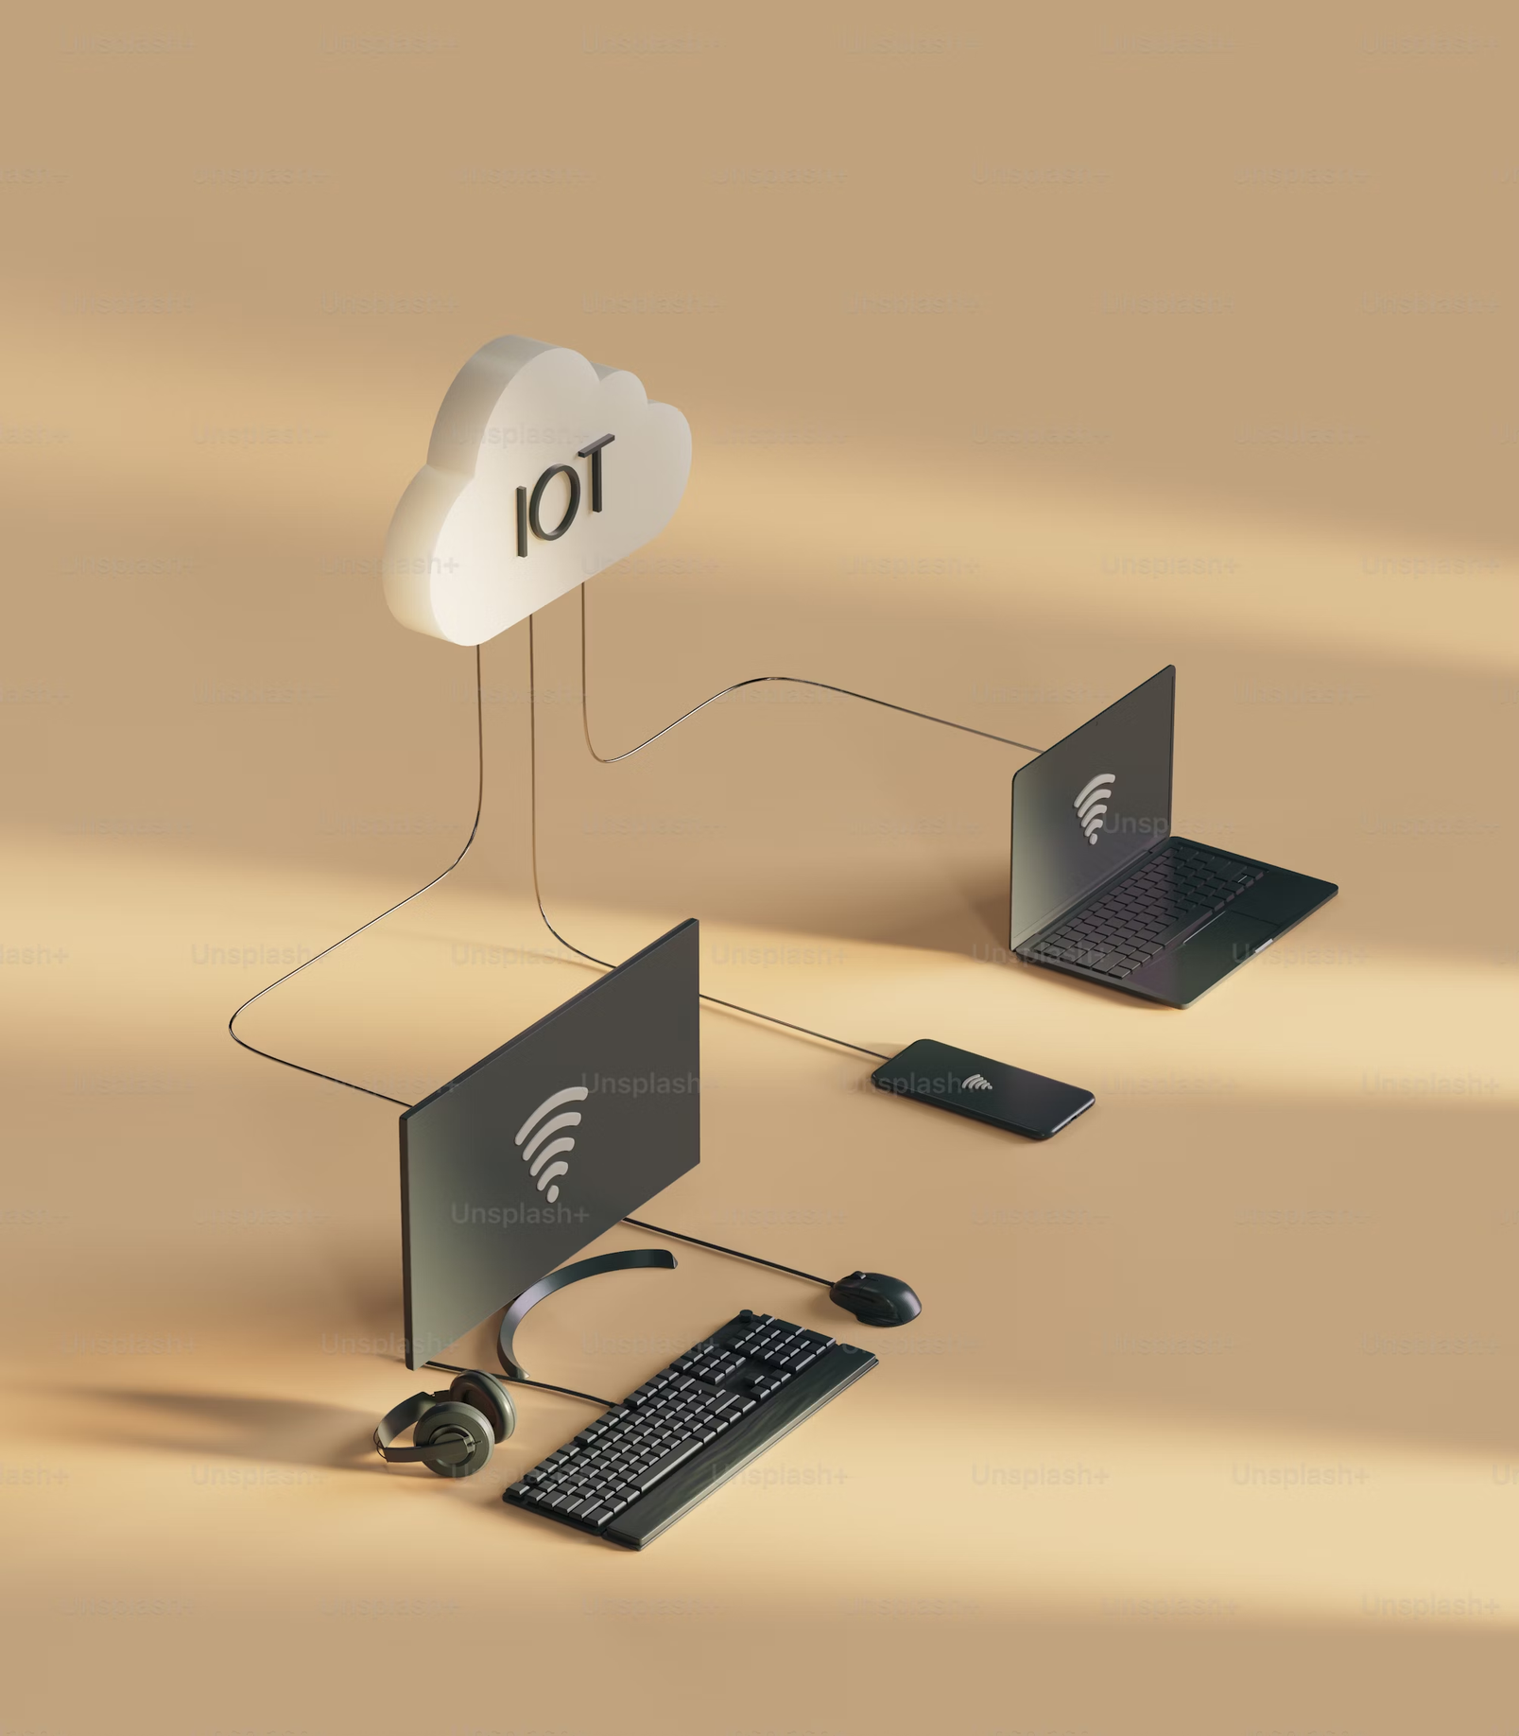

Profiling the Energy Impact of Fuzzing for Constrained Environments
Presented By:
G. Manideep

Slide 2

INTRODUCTION
Fuzzing is essential for vulnerability detection but most existing tools are optimized for high-resource systems, not constrained environments.
Energy consumption is a critical yet overlooked factor in fuzzing on IoT and embedded platforms like the Raspberry Pi.
This study offers the first empirical comparison of energy usage and performance of four popular fuzzers (AFL++, LibFuzzer, Honggfuzz, Radamsa) on a low-power ARM device.

Slide 3
PROBLEM STATEMENT
Objective:
While fuzzing is widely used for vulnerability detection, its energy impact on resource-constrained platforms remains largely unexplored. This gap limits the practical deployment of fuzzers on IoT and embedded systems where power efficiency is critical.

Slide 4
NOVELTY OF THE APPROACH
Energy-Centric Fuzzing Evaluation: The paper conducts the first detailed energy profiling of four popular fuzzers (LibFuzzer, AFL++, Honggfuzz, Radamsa) on a Raspberry Pi 4, focusing on performance metrics relevant to low-power IoT and embedded environments.
Controlled, Comparative Analysis: Each fuzzer is evaluated under identical, controlled conditions using metrics like throughput (exec/sec), average power draw (Watts), and energy per input (Joules), enabling a direct comparison of efficiency trade-offs.
Practical Benchmark Insights: The study identifies that LibFuzzer offers the best energy-per-execution efficiency (6.4 µJ/input), while AFL++ consumes the least power overall (0.095 W)—providing practical guidelines for choosing fuzzers based on energy constraints.

Slide 5
PROPOSED APPROACH
Benchmark baseline power usage using traditional fuzzers (AFL++, LibFuzzer, Honggfuzz, Radamsa) on a common C-based fuzzing target.
Execute inputs and monitor power consumption using a USB power meter for runtime profiling.
Run each fuzzer for a fixed 5-minute window (300 seconds) and repeat three times to ensure result consistency.
Analyze energy-per-input and functional coverage.
Record and compare the following metrics:
- Throughput (inputs/sec)
- Average Power Consumption (Watts)
- Energy per Input (Joules/test)
- CPU Utilization (%)
Analyze trade-offs between speed and energy efficiency to guide fuzzer selection for energy-constrained systems.

Slide 6
METHODOLOGY
Baseline fuzzers (AFL++, LibFuzzer, Honggfuzz, Radamsa) compiled and executed natively on Raspberry Pi 4.
Each fuzzer was run independently for a fixed duration (300 seconds) on a common test program png_check.c
Inputs included valid and invalid PNG-like files; fuzzers mutated them using their respective strategies.
Power usage logged using USB power meter during baseline fuzzing
CPU frequency was fixed using the "performance" governor to reduce variability.
Execution throughput (inputs/sec), CPU utilization, and energy-per-input (Joules) were calculated.
Experiments were repeated 3 times per fuzzer; average metrics were used for comparison.

Slide 7
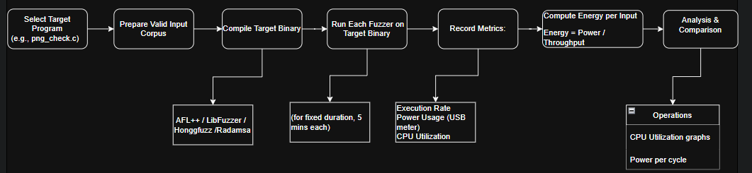

Slide 8
MODE OF EVALUATION
• Evaluation Platforms:
Raspberry Pi: Demonstrate on a physical IoT device with limited resources
• Metrics:
Fuzzers : AFL++, Hoong fuzz, Libfuzz, Radamsa.
Energy consumption per fuzzing iteration and number of iterations
Code coverage improvements compared to conventional fuzzers
• Test Environment:
Integration with power measurement tools (USB power meter) and profiling software (e.g., powerstat, h host)

Slide 9
Fuzzer | CPU Usage | Voltage (V) | Current (A) | Power (W) | Temp (°C) | Total mAh | Total mWh | Loops | Exec/sec | Notes
LibFuzzer | 100% | 5.202 | 0.226 (avg) | 0.310 (const) | 26 | 320 | 1653 | 365,755 | 48,386 | High current: 0.98A, Low: 0.54A, High W: 0.476, Low: 0.290
AFL++ | 125% | 5.202 | 0.20 (avg est.) | 0.095 | 28 | 288 | 1486 | 322 | ~1,000 | High A: 0.24, Low: 0.15, High W: 0.114, Low W: 0.077
Honggfuzz | 94% | 5.202 | 0.151 (const) | 0.755 (avg est) | 29 | 305 | 1575 | 22,970 | 76 | Threads: 2, 57% coverage, added 19 units
Radamsa | 94% | 5.202 | 0.151 (const) | 0.383 (avg est) | 29 | 337 | 1736 | 100 | ~300 | High A: 0.67, Low: 0.13, High W: 0.306, Low W: 0.46

Slide 10
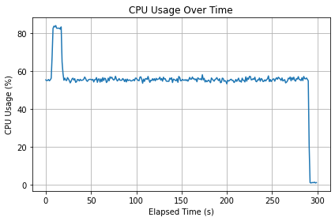
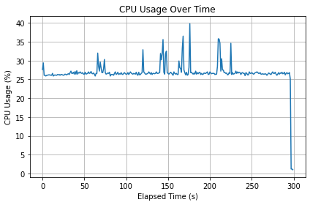
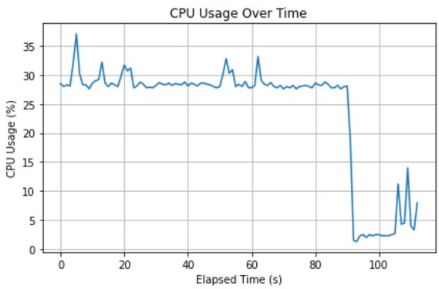
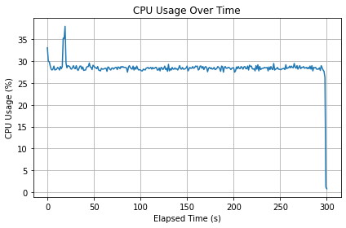
CPU Utilization Graphs
(b) HonggFuzz
(a) AFL++ Fuzzer
(c) LibFuzz
(d) Radamsa

Slide 11
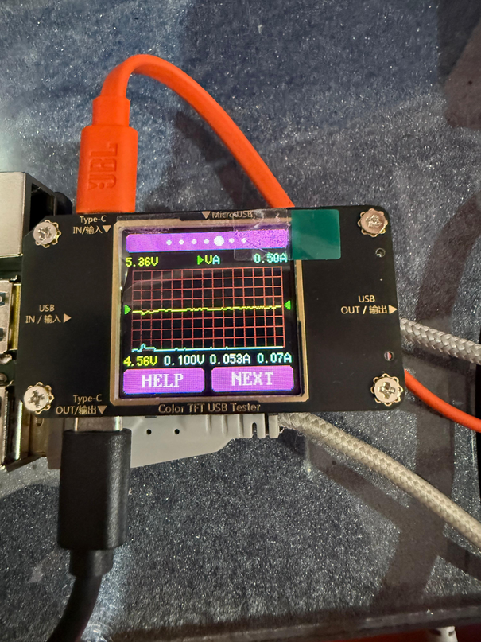
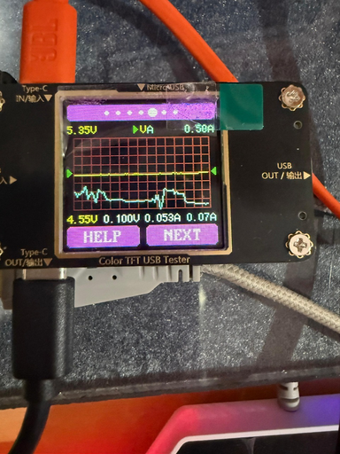
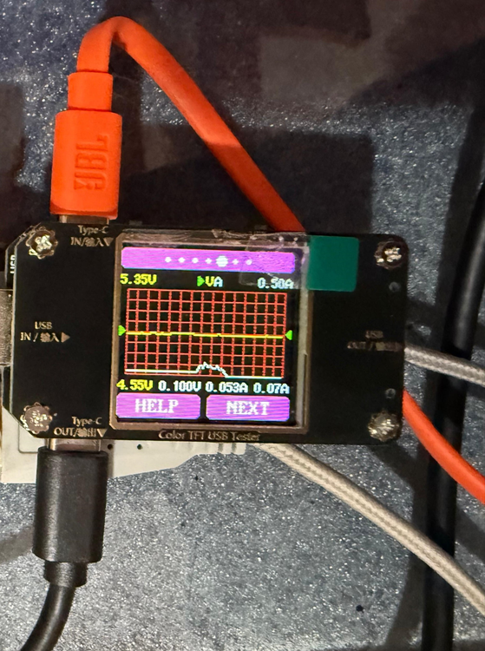
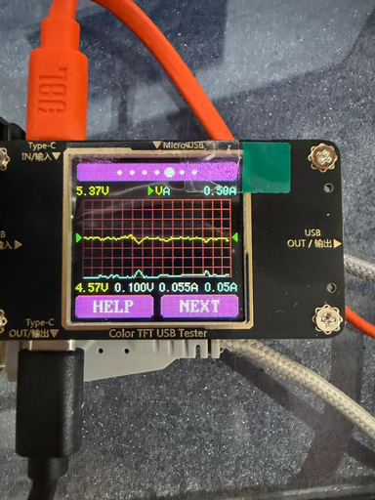
Energy Analysis
(a) AFL++
(c) LibFuzz
(b) HonggFuzz
(d) Radamsa

Slide 12
SUMMARY & KEY TAKEAWAYS
Baseline Profiling Completed: Power and performance of AFL++, LibFuzzer, Honggfuzz, and Radamsa were benchmarked on Raspberry Pi 4.
Energy Measurement Setup: Used USB power meter and powerstat tools to record real-time power draw during fuzzing.
Performance Variation Observed:
LibFuzzer achieved the highest execution throughput (~48k exec/sec).
AFL++ had the lowest power usage (0.095 W), making it most energy-efficient per watt.
Trade-offs Identified:
Honggfuzz consumed the most power but delivered the lowest throughput.
Radamsa had mid-range power and throughput but lacked coverage feedback.
Practical Insights:
Lightweight fuzzers like AFL++ are ideal for battery-powered devices.
High-throughput tools like LibFuzzer are best when speed is prioritized over power savings.

Slide 13
THANK YOU

